Slide 1
Accommodations as a relational concept
The importance of quality relationship between autistic employees and their supervisor
Valérie Martin, Ph.D., Professor in occupational heath and safety management martin.valerie.3@uqam.ca | IDEA Web series 2024-06-21

Slide 2
Outline
Autism and employment
Employment support services for autistic individuals
Relationship between the worker and his or her supervisor
Accommodations and relations

Slide 3
Autism and employment
58,200 autistic Canadians aged 15-64 (0.2%)
  0.7% of the population between 15 and 24 years old
Autistic individuals have an employment rate well below the general population
  About 25% of adults with developmental disability are employed vs. 61.6% of adults without disabilities
  Duration of employment – 4 to 5 jobs in 5 years
  Among autistic people in employment, 44.9% work full time
  Report underemployment
Co-occurring mental and physical health conditions create additional barriers
(Berrigan et al., 2020; Ohl et al. 2017)

Slide 4
Autism and employment
Difficulties experienced in social interactions, atypical cognitive functioning and behaviors, sensory issues can interfere with employability
Double empathy problem
  difficulties are due, in part, to a lack of mutual understanding,
    most autistic people struggle to understand and empathize with non-autistic people,
    most non-autistic people also struggle to understand and empathize with autistic people.
  Communication is bidirectional and a shared responsibility
(Milton, 2012)

Slide 5
Autism and employment
Difficulties of autistic individuals | Obstacles in the workplace
Target jobs Job search Selection process Adapting to a new job Training Organizing at work Instructions Social relations Behaviors atypical or unsuitable for the workplace | Prejudice and discrimination Organizational culture Supervisory practices Organizational policies Physical environment
Martin, 2018, https://www.rnetsa.ca/fr/centre-de-documentation/emploi

Slide 6
An ecosystem approach to employment for autistic individuals
S
Autistic individual
Family and relatives
Specialized employment support services
Educational services
Community
Transport – Housing –
Health and social care –
Social benefits
Workplace
Societal values
Public policies
(Nadig & Martin, 2021; Nicholas et al., 2018; Martin, 2018; Scott et al., 2019; Vincent & Fabri, 2020)

Slide 7
What is the profile of autistic individuals requesting employment support services?
How useful are these services?
Martin, V. et Lanovaz, M. J. (2021). Program evaluation of a community organization offering supported employment services for adults with autism. Research in Autism Spectrum Disorders, 82. https://doi.org/10.1016/j.rasd.2021.101741

Slide 8
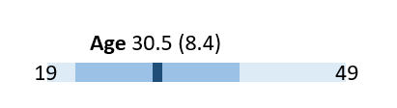
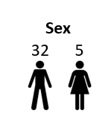
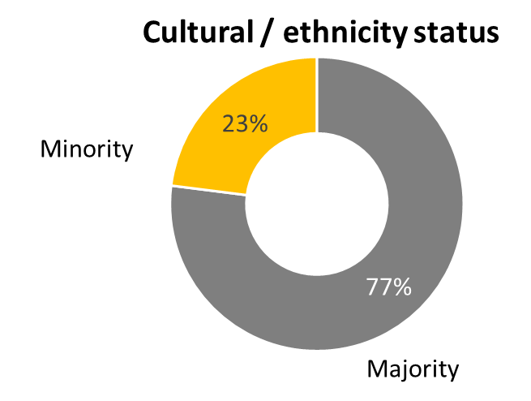
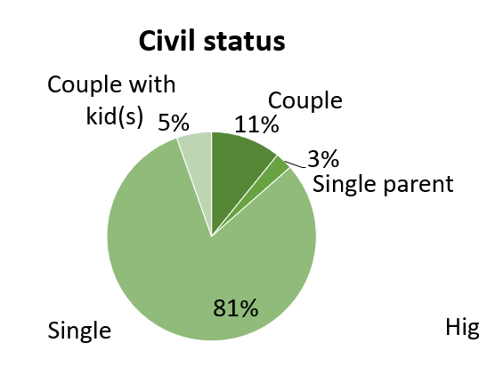
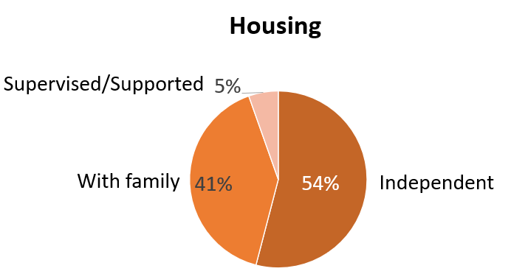
Participants socio-demographic characteristics
8

Slide 9
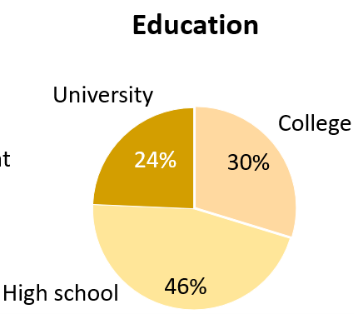
Participants socio-professional characteristics
(Waghorn et al., 2005)
(S.D.)
(13,6)
(16,5)
(17,9)
(21,9)
(12,6)
No confident
at all
Completely
confident

Slide 10
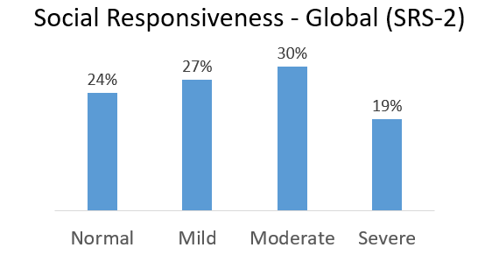
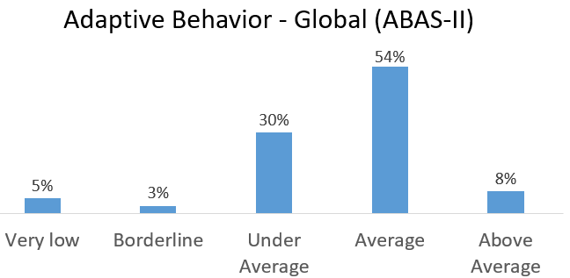
Participants clinical characteristics
Higher trait anxiety than working-age population (p<0.001)
Higher anxiety toward work than working-age population (p<0.001)
62% had cooccuring conditions
  Such as ADHD, Anxiety, Depression
(Spielberger, 1983)

Slide 11
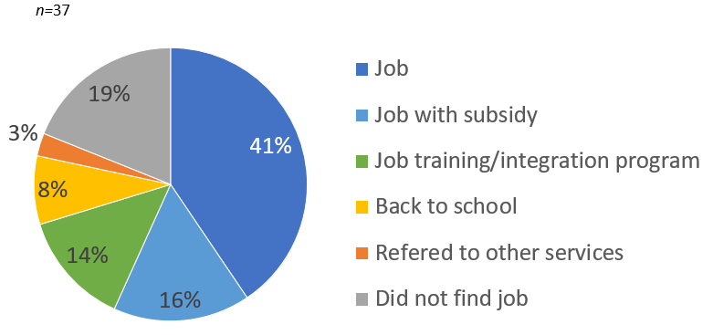
Impact of services
Finding employment
Employment duration
3.6 months average duration
9 = Employment / 4 = Program
7 = first work experience
  Many later found another job
Job harassment at work

Slide 12
What are the key factors that influence the integration process of an autistic employee, when receiving employment support services?
Martin, V., Flanagan, T. D., Vogus, T. J. et Chênevert, D. (2022). Sustainable employment depends on quality relationships between supervisors and their employees on the autism spectrum. Disability & Rehabilitation, 1-12. https://doi.org/10.1080/09638288.2022.2074550

Slide 13
Methods
(Miles et al, 2014)
Interviews = 9 case histories
  9 autistic employees (3 months on the job)
  4 cases - 1 interview – supervisor
  5 cases - 2 or 3 interviews (employee / supervisor / job coach) + notes in file
Variety
Employees’ profile Job Organization size and type Business sectors | with or without subsidy Positive and negative outcomes

Slide 14
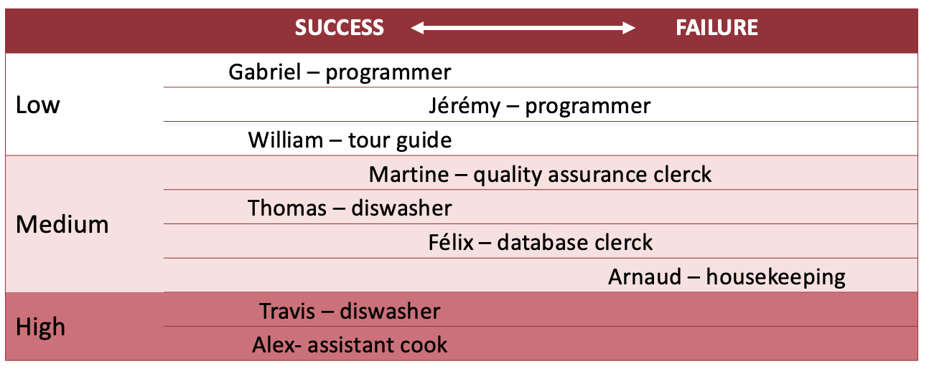
Support needs for communication
"Success" and/or "failure"

Slide 15
The success or failure of the integration process seemed to depend on the relationship between the manager and the autistic employee
Finding 1

Slide 16
Leader-member exchange theory (LMX)
(Graen, 1976; Dulebohn et al., 2011; Colella et Varma, 2001)
Supervisors develop different relationships with each of their subordinates
High-quality supervisor-employee relationships
  ↗ supervisor support and coaching
  ↗ employee satisfaction and performance
  ↘ employee turnover rate

Slide 17
Social exchange theory
(Blau, 1964)
Reciprocity
Supervisor
Economic outcomes | Socioemotional outcomes
Gives extra time and effort to his, her employee Receives work performance [expectations] | Receives a moral/social reward Proud to help / contribute to society see his, her employee grateful or happy to have a job see his, her employee grow and flourish Recognition from management external (family or other)

Slide 18
Socioemotional outcomes
  “ what impressed us was that we brought out his strengths”
  « It's still gratifying [...], I liked it, this experience, even if, uh, if there were clashes ».
  « I think everyone is proud of that at the end of the day. Even my employees. We help a little in our community ».

Slide 19
Antecedents of the LMX relationship
Antecedents
  Perceived similarity
  Positive emotions / liking
  Trust
  Positive expectations of employee
Familiarity with autism
“Personal relationship” with autism
Motivation to hire someone different

Slide 20
Development of the LMX relationship
Trust develops (or fails to develop) as a result of a mutual testing process
Satisfactory employee responses to manager's tests lead to increased trust
Disappointment → low quality of LMX relationship
(Erdogan & Bauer, 2015; Maslyn and Uhl-Bien, 2001)

Slide 21
Failure - relationship development
Employee not progressing
  « for me it's, not to have any [disabled employees] honestly, I'd be unhappy". "But he stayed closed. He really stayed closed, he closed after a week, then he stayed closed ».
Employee who seems unmotivated
  « this demotivation and the fact that he has really, really started to focus on other things at work. But… no employer can accept that. »

Slide 22
The quality of the relationship between the manager and the autistic employee was influenced by the action of the job coach, who facilitated communication between the manager and the employee.
Finding 2

Slide 23
Role of the job coach
Employment support services contribute to job maintenance by strengthening the LMX relationship
  associated with positive results for employees
The job coach influences the relationship between manager and employee
  Raises awareness
  Facilitates mutual understanding
  Adapts means of communication
  Shapes expectations
  Varies according to
    Employee
    Supervisor
    Job

Slide 24
Reassures the manager
Understands his employe
→ antecedent to LMX relationship
  Manager: "we talked about a lot with [the job coach] about everything psychological. His profile. That's for sure. At the same time, his limitations, his personality.
  Manager: [autism] "It can be destabilizing. You have to deal with it beforehand. But that's something you have to learn, the first time too, to do things right."

Slide 25
COMMUNICATION
Job coach demonstrates:
- giving instructions,
- communicating with the employee
  Job coach: "I was trying to explain a little bit how things should be presented to him, so that he'd be clearer."
  Manager: "When I saw how [the job coach] was taking... talking to Martine, then behaving with her, during those three days, well that allowed me to... to, to loosen up a little". This change was positive and didn't affect Martine. Now [...] things are said, and Martine isn't more anxious than that either."

Slide 26
Facilitating mutual understanding
Unexpected behaviors that can generate rejection
  Manager: "When it's lunchtime, and we're eating in the cafeteria, and we start talking, people don't know what to do because Martine will say the same thing 10 times: "The pasta's good, the pasta's good, they’re good".

Slide 27
Shapes expectations
Predisposes to positive performance perception
Job coach: "He's good at black and white stuff, he's very efficient, he's very quick at doing things clearly and precisely. Can we [laughs] just give him these tasks and delegate the grey rules to someone else?"
LMX relationship quality is related to perceived performance vs. objectively measured performance

Slide 28
Role of the job coach
Develop the relationship
  Captures subtle social cues that the employee may not detect or interpret
    On-site presence
  Makes "socio-emotional outcomes" visible
    Highlights employee progress,
    Underlines employee appreciation,
    Recognition of the manager
++employees with difficulties seeing that others may have other points of view
++employees whose emotions are hard to read on their faces

Slide 29
Failures - No request for support
Job coach | "when I was calling him, my client would say: 'It's going well' ".
Supervisor | misinterprets employee behaviour "In the employee lounge, he didn't mix with anyone, didn't talk to anyone, nothing. You know, it was really, it was really, he was closed off. I don't know why."
 | decides to fire his employee "I can't see myself telling him, telling him, you know, trying to reprimand them [...]. I said: 'you know, these people don't deserve that, it's not...'. And I said: [...], I don't think we're going to get anywhere".

Slide 30
Other contributing factors
Co-workers
Flexibility of rules and policies
Wage subsidies
Importance of the supervisor
opens door
sets the tone
enables implementation
SME

Slide 31
Accommodations as a relational concept

Slide 32
Accommodations as a relational concept
Importance of a good supervisor-employee relation for job retention, employer support, job performance, job satisfaction
Accommodation takes place IN the relationship, in everyday communication
  Challenge for the non-autistic partners = daily, in most situations
  CRISPESH (2024). Facilitating neuromixed communication in the workplace: a guide for allists (non-autistic) [in FRENCH]

Slide 33
Changes - social environment
Attitudes
Work organization
  Schedule (hours, flexibility, pace)
  Teleworking
  Tasks and duties
  Routine, flexibility
Training
Communication

Slide 34
Accommodations as a relational concept
Accommodations during organisational socialization
  Organizational tactics, new employee behaviors
  Observation of social behaviors, communications, social rules
(Bauer et al. 2007)

Slide 35
Accommodations as a result of negotiation
Obtaining an accommodation depends on a process that is also relational
  Negotiation
  Iterative, non-linear, interactive
  Social, relational and political factors
  Social capital of the individual needing the accommodation
Stakeholders
  HR
  Supervisor
  Union
  External professionals
(Hossain et al, 2021)

Slide 36
Inclusive leadership
(Rander et al., 2018; Karkmaz et al. 2022)
fostering employee's uniqueness
  (e.g., promoting diversity)
strengthening belongingness within a team
  (e.g., building relationships)
showing appreciation
  (e.g., recognizing efforts and contributions)
supporting organizational efforts
  (e.g., promoting organizational mission on inclusion)

Slide 37
Main take-aways
Diverse profile of autistic workers
Specialized employment support services are useful to find jobs, but workers and supervisors still need support afterwards
Communication is a reciprocal / bidirectional activity in the daily life of the organization
Adapting communication is a crucial accommodation for autistic workers
  leads to improved supervisor-employee relationship
  positive employment outcomes

Slide 38
Main take-aways
Job coach should
  focus on developing/improving relationships, as much as on professional tasks
  Support the negotiation of accommodations
Inclusive leadership supports the provision of relational accommodations

Slide 39

Thank you

Slide 40
Additional material

Slide 41
Development of quality leader-member relationship leading to ongoing employment for an autistic employee
Manager
Job coach
Autistic employee
Offers job opportunity
Evaluates fit
Reassures the manager
Offers skills
Gives extra time + efforts
  Onboarding
  Training
  Tasks
  Rules
  Communication
  Feedback
Support onboarding and training
Demonstrates efforts
Adapting
Sensitize manager on autism and employee’s needs
Demonstrates motivation and interests
Shapes expectations
Asks for support
Provides problem-solving
Asks for support
Facilitate communication
→ mutual understanding
  Expectations
  Dissatisfactions
  Appreciations
Gives expected work performance
Receives expected work performance
Receives gratification
  Feels proud/good
  Recognition at work
  Recognition outside of work
Shows appreciation of
job / manager
Shows growth outside of work
SUSTAINED EMPLOYMENT
Martin, V. 2020

Slide 42
Changes - physical environment
Physical environments
  Accessible facilities
    Ramp, bathrooms, door
  Alarms (light, sound, vibration)
  Parking
Workstations and tools
  Light, noise
  Furnitures, mat
  Phone, keyboard
  Alarms
  Softwares
  Separate office
  Normalizing the use of assistive device

Slide 43
Tasks of neuroinclusion professionals
With the person:
Pre-employment support (research, interview)
Learning the task
Task adaptations (pictograms, etc.)
Help with social relations
With the employer:
Awareness
Adaptations of management processes
Help with social relations
Métayer, 2022

